Slide 1
Slaviša Đurđić
Global Burden of Disease
Goal: Analysis of the Tableau “Global Burden of Disease” health data sample dataset with Looker Studio.
Instructions:
- Collect data by downloading the Excel file from https://public.tableau.com/app/learn/sample-data?qt-overview_resources=1#qt-overview_resources.
- Connect to the file from Looker Studio and build visuals (https://lookerstudio.google.com/reporting/5f9ff298-dc67-4d7a-a662-6edd4fad6b2e/page/p_yzjndubgbd).
- Perform multivariate analysis in Python to predict output based on both, numerical and categorical values.
Belgrade, November 2023

Slide 2
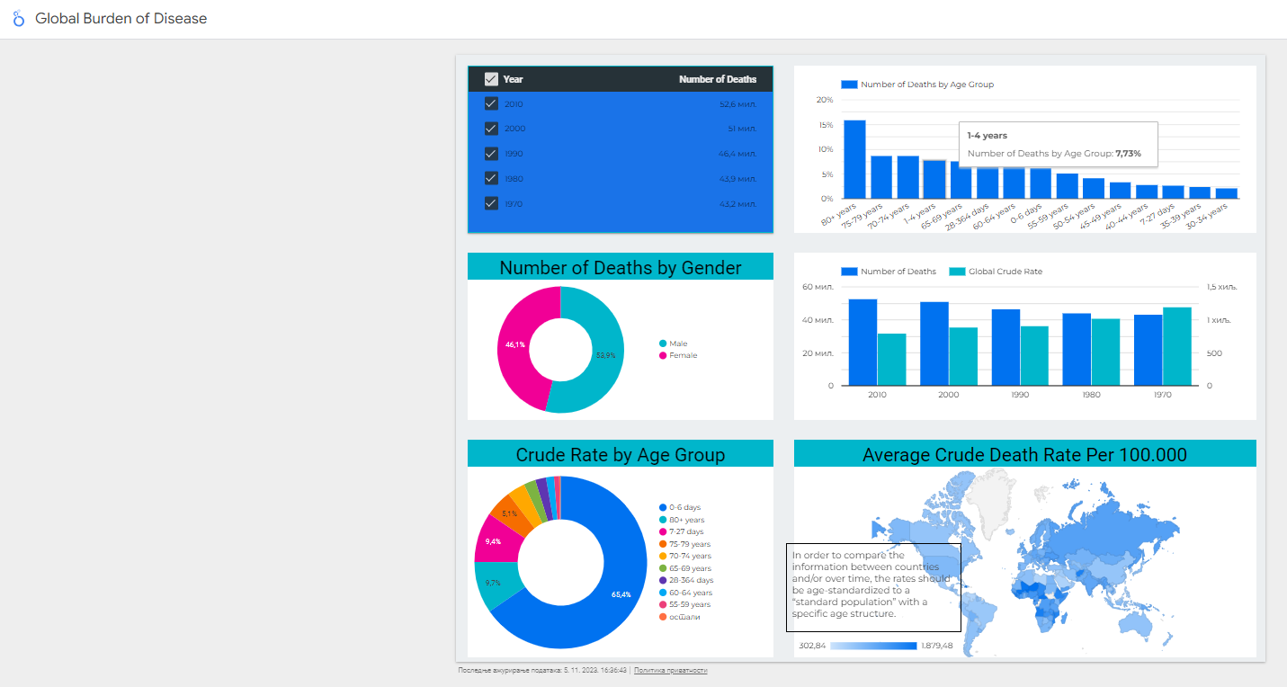

Slide 3
Global Burden of Disease Project Insights
Mortality rates are falling around the world. Globally, 52.6 million deaths occurred in 2010, approximately 13.5% more than in 1990 and 21.9% more than in 1970. But the global crude death rate has fallen from 11.7 to 7.7 per 1,000 population due to the much larger (86.7%) relative increase in world population – from 3.7 billion in 1970 to 6.9 billion in 2010.
The world has made tremendous progress fighting child mortality. Deaths of children under the age of 5 were cut by more than half from 16.38 million in 1970 to 11.55 million in 1990 and then to 6.84 million in 2010, although the global annual number of births increased by 12%. This progress has beaten every published prediction. However, child mortality remains a pressing issue. Effective interventions are available to prevent many of the remaining 6.8 million child deaths.
African countries and South Asia have the highest death rates.

